Slide 1



Effect of valve holding chamber on the dynamics of aerosol: Time resolved velocimetry study.
Brenda Hervieu¹, Anthony Besq², Jean-Regis Angilella² & Thierry Porée¹
1 OptimHal Protec’Som, Valognes 50700, France
2 Normandie Université, UNICAEN, UNIROUEN, ABTE, Caen, 14000, France

Slide 2

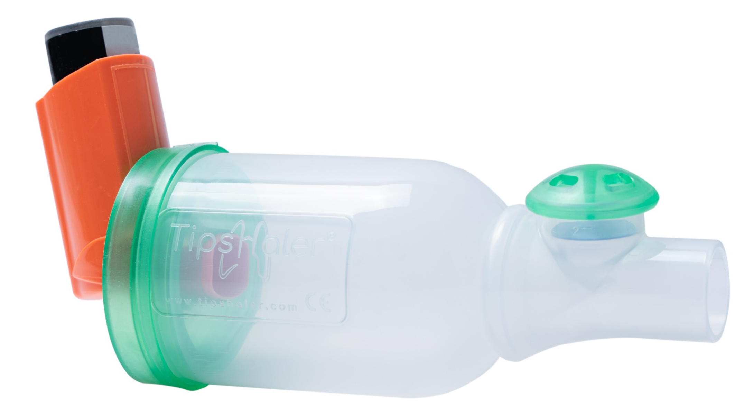
pMDI is used in the treatment of many respiratory diseases:
  Hand-lung coordination,
  High-speed velocities,
  Oropharyngeal impaction.
VHC is commonly used to improve the efficiency of drug delivery by reducing the need for good hand-lung coordination and limiting the oropharyngeal impact:
  Decrease velocity,
  Retain drug particles.
1

Slide 3

Success of inhalation therapy depends on several factors, including the patient, and the size and velocity of drug particles.
The aim of this study focuses on the dynamics of aerosols emitted in a VHC according to the inspiratory flow rate, using as a reference the free jet which is the jet emitted without an inhalation chamber.
The dynamics were studied using time-resolved particle image velocimetry (PIV) for two different formulations:
  a solution of beclomethasone dipropionate (BDP),
  a suspension of fluticasone propionate (FP).
2

Slide 4
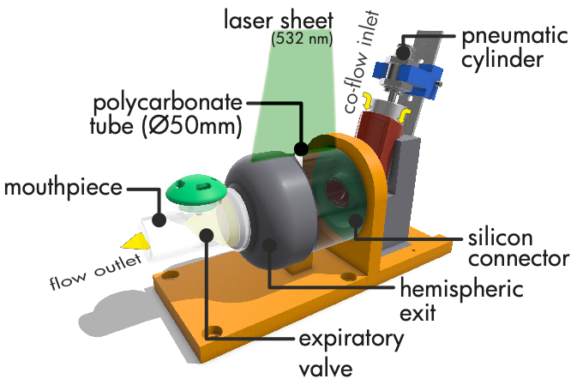
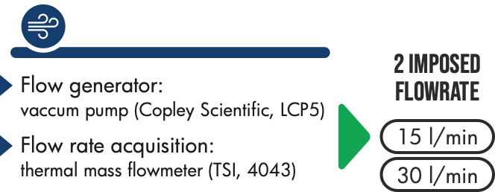
3

Slide 5


Simultaneous acquisition
Delay between shaking and actuation
4

Slide 6
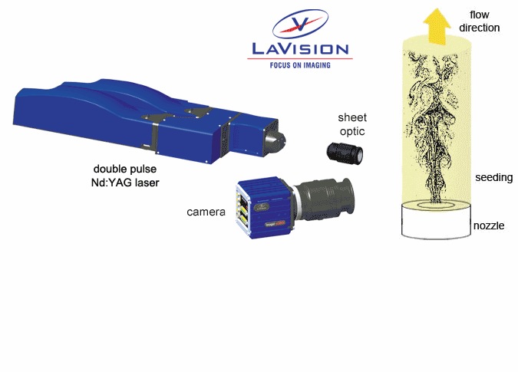
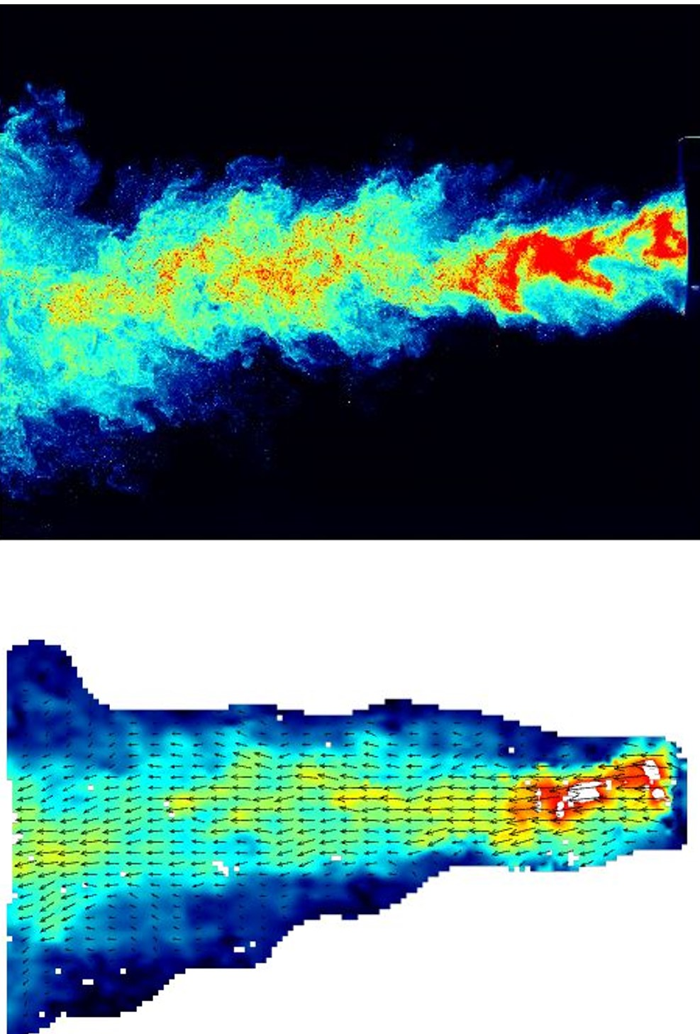
PIV is based on the recording of successive images of particles which was considered like a tracers illuminated by a laser beam.
  High Speed camera (Phantom v2640),
  MESA PIV (532-80L) Nd:YAG pulsed laser (wavelength of 532 nm) with a repetition rate up to 30 kHz and a pulse width lower than 150 ns.
1
Paire of images
=> Query windows
2
Cross correlation between area
3
Velocity field
1
2
3
5

Slide 7

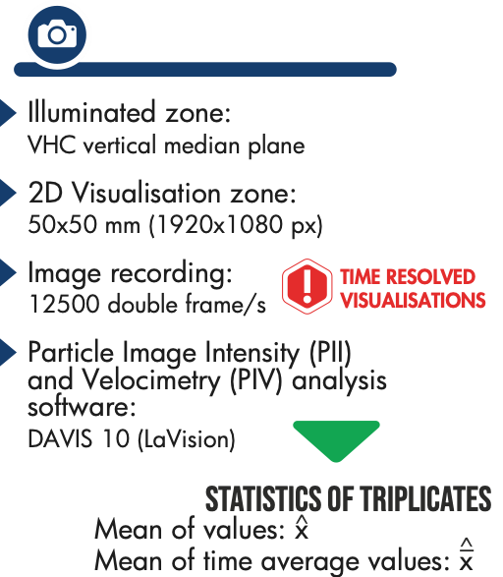
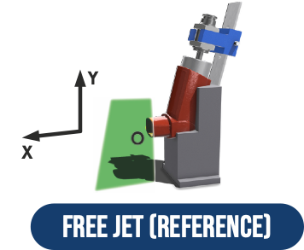
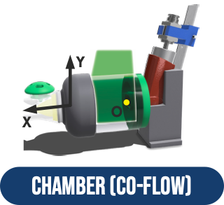
6

Slide 8





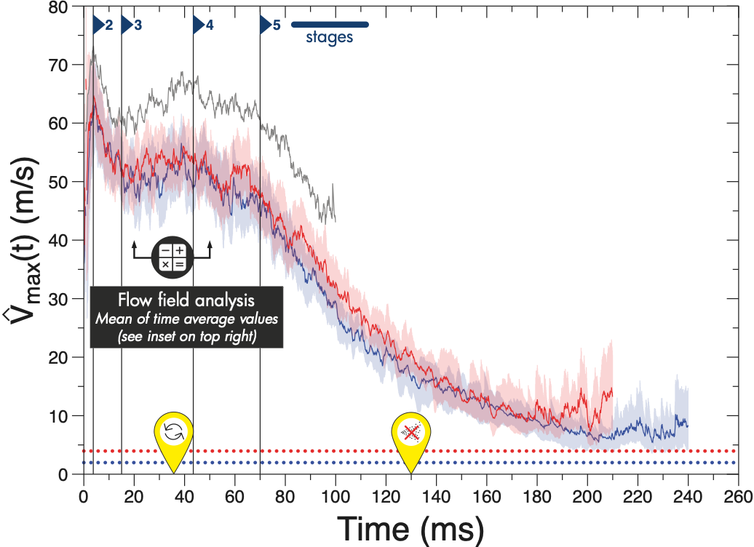
: temporal evolution
The temporal evolution of the maximum velocity recorded for the triplicates:
  Five stages
    1: rapid increase, max 78 m/s
    2: slowdown of about 18 m/s
    3: increase, 70 m/s
    4: slow decrease
    5: rapid decrease
Emission duration lasts 130 ms
7

Slide 9
: temporal evolution
The temporal evolution of the maximum velocity present five stages.
The temporal scenario remains similar.
Maximum velocities at 15 and 30 L/min are similar – 10 m/s lower than the free jet.
8

Slide 10

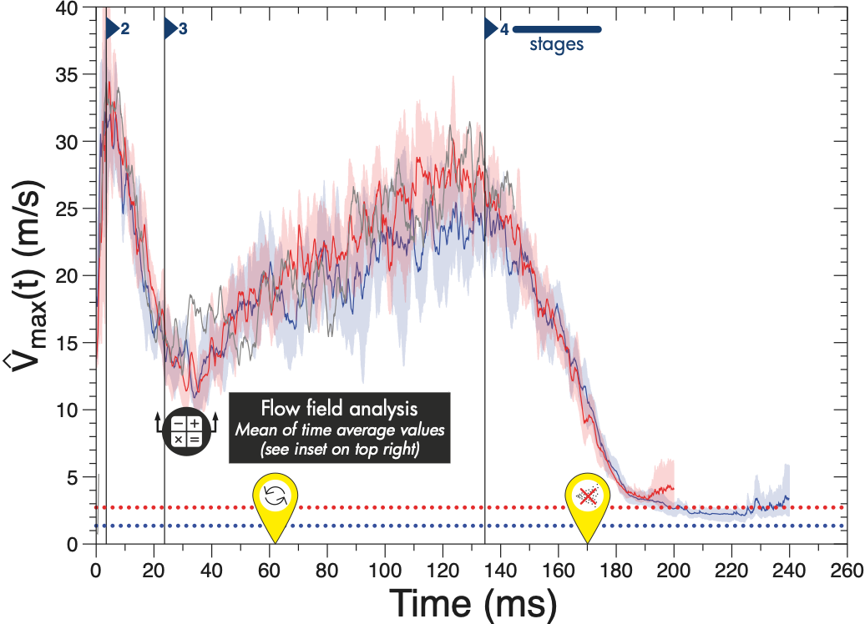
: temporal evolution
The temporal evolution of the maximum velocity recorded for the triplicates:
  Four stages
    1: rapid increase, max 34 m/s
    2: slowdown of about 19 m/s
    3: increase, 30 m/s
    (longer than FP Δ= 80 ms)
    4: decrease
Emission duration lasts 170 ms
9

Slide 11
: temporal evolution
The temporal evolution of the maximum velocity presents four stages.
No difference for the maximum velocities for the free jet or at 15 and 30 L/min.
10

Slide 12
: temporal evolution
 | FP | BDP
Maximum Velocity | 78 m/s _ 70 m/s | 34 m/s _ 30 m/s
Flow rate and chamber influence | Decrease | No influence
Jet duration | 130 ms | 170 ms
Stages duration | Shorter | Longer
11

Slide 13
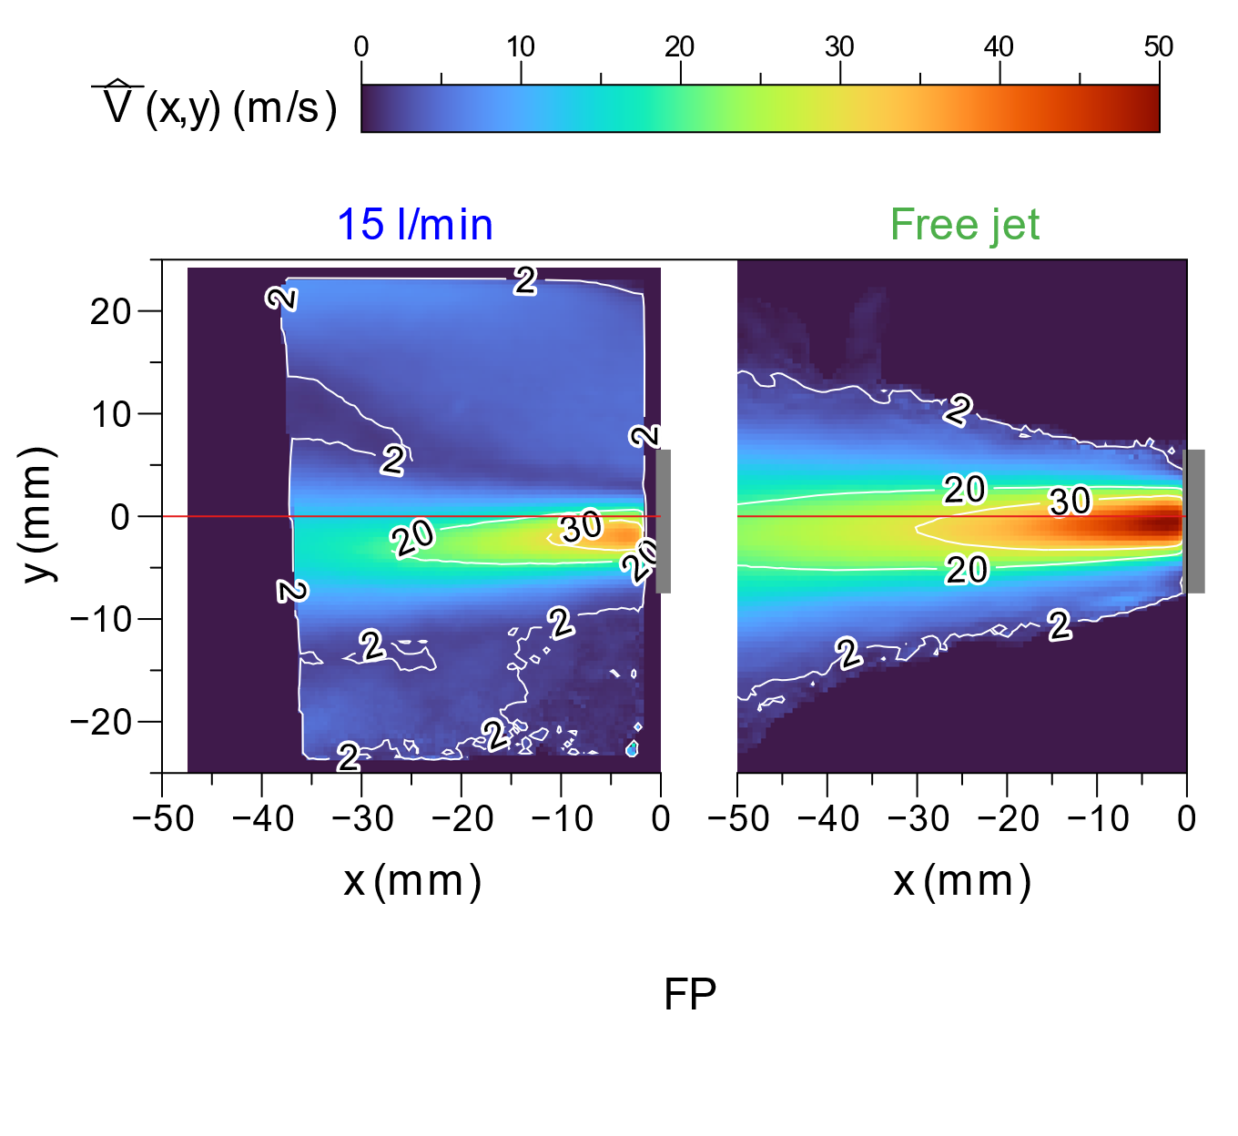
: Velocity magnitude fields
Time average velocities (20 ms)
Free jet:
Axisymmetric,
Mean velocities 50 m/s,
Decrease along both x and y axes,
At 3 cm = 30 m/s.
12

Slide 14
: Velocity magnitude fields
Time average velocities (20 ms)
Free jet:
Axisymmetric,
Mean velocities 50 m/s,
Decrease along both x and y axes,
At 3 cm = 30 m/s.
In a chamber:
Mean velocity decrease 35 m/s,
Decrease along both x and y axes,
At 3 cm = 20 m/s,
Shifted toward the lower part.
13

Slide 15
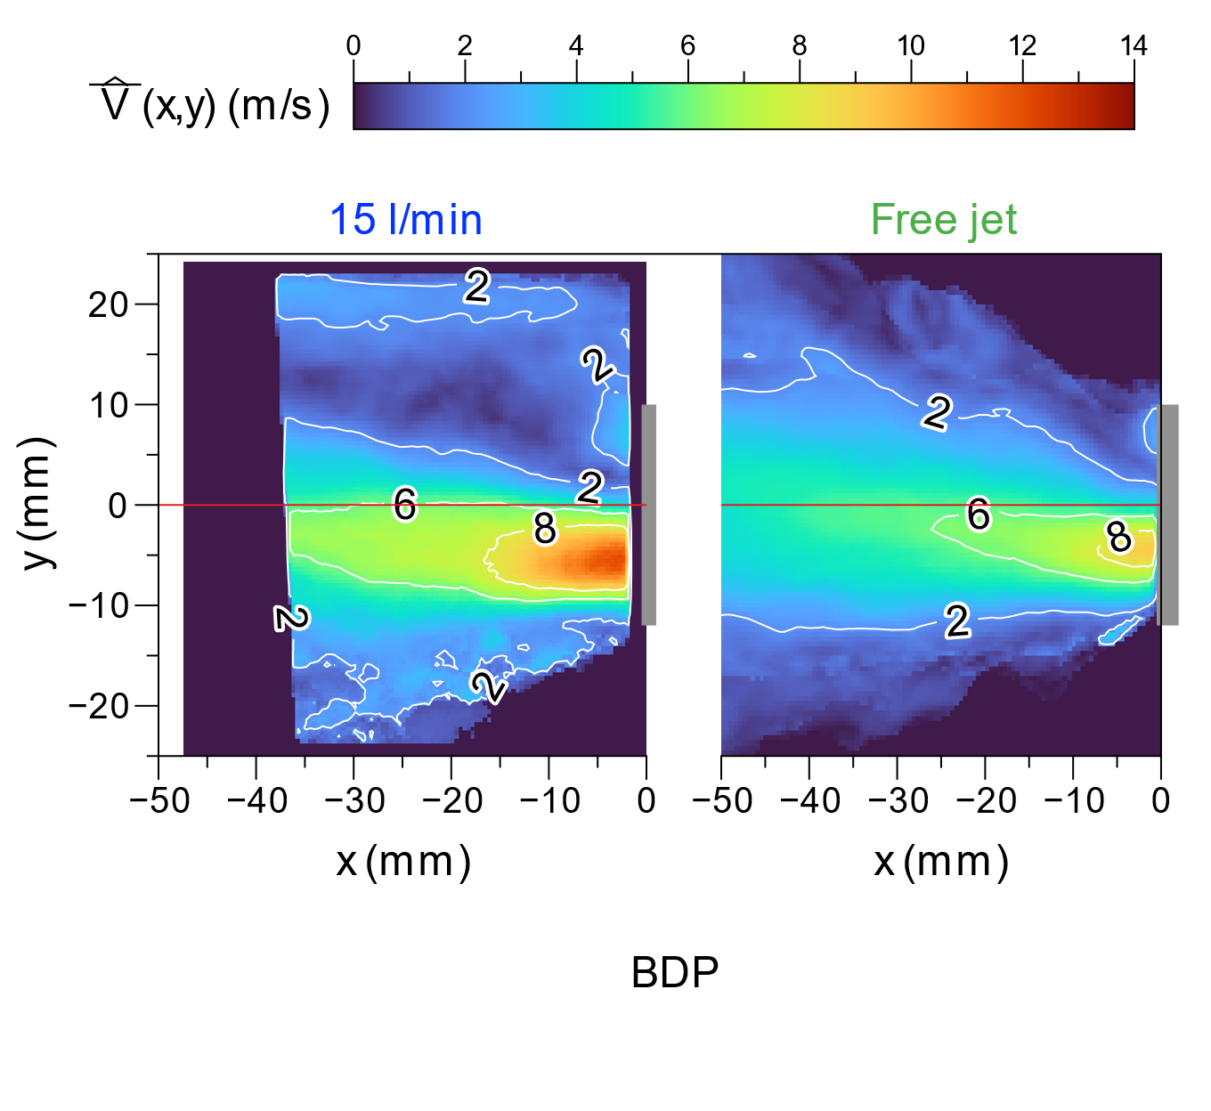
: Velocity magnitude fields
Time average velocities (20 ms)
Free jet:
Non symmetric,
Mean velocities 8 m/s (lower part),
Decrease along both x and y axes.
14

Slide 16
: Velocity magnitude fields
Time average velocities (20 ms)
Free jet:
Non symmetric,
Mean velocities 8 m/s (lower part),
Decrease along both x and y axes.
In a chamber:
Non symmetric,
Mean velocity increase 12 m/s (lower part),
Decrease along both x and y axes.
15

Slide 17
Free jet:
Two formulations with the same temporal pattern but different characteristics (nozzle, composition)
  Velocity,
  Duration.
 | FP | BDP
Maximum Velocity | 78 m/s _ 70 m/s | 34 m/s _ 30 m/s
Flow rate and chamber influence | Decrease | No influence
Jet duration | 130 ms | 170 ms
Stages duration | Shorter | Longer
In a chamber:
Not affect the temporal pattern,
Velocity can increase (BDP) or decrease (FP) with the co-flow.
16

Slide 18
Thank you for your attention

